Slide 1

SSGMCE , Shegaon.

Slide 2
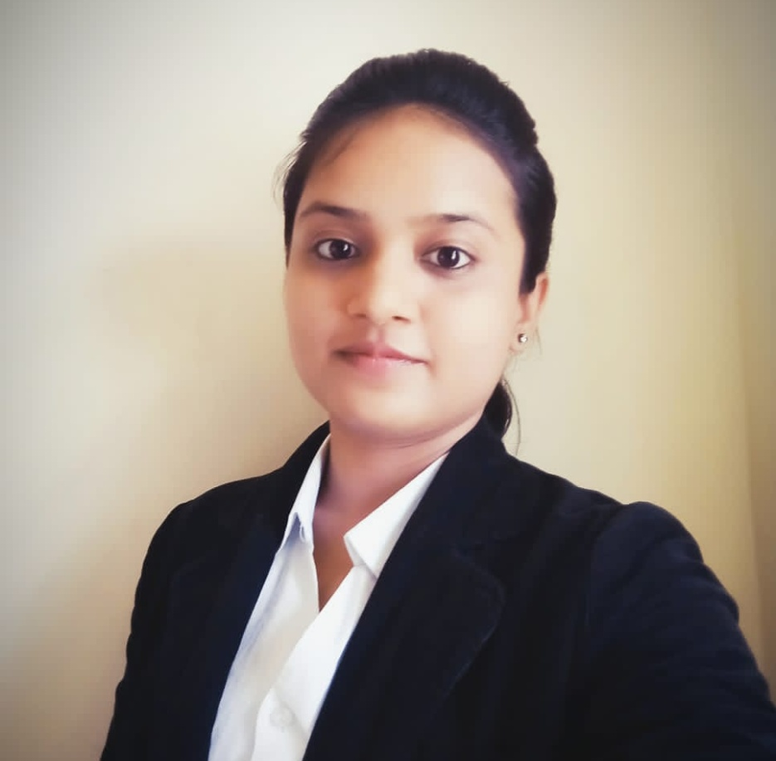
Tasks:-
Interacting with faculties & event’s external guests.
Informing info. to team which will be told from faculty advisor and planning working strategy .
Assigning work to Core team members and taking care of its perfect completion .
Reporting to Faculty advisor about team’s status and all team member’s performance.
Maintaining important confidential data of ESSA.
Extra tasks :-
Website’s responsibility .
Chair-person of ESSA
Ms. Shweta Bhagat

Slide 3
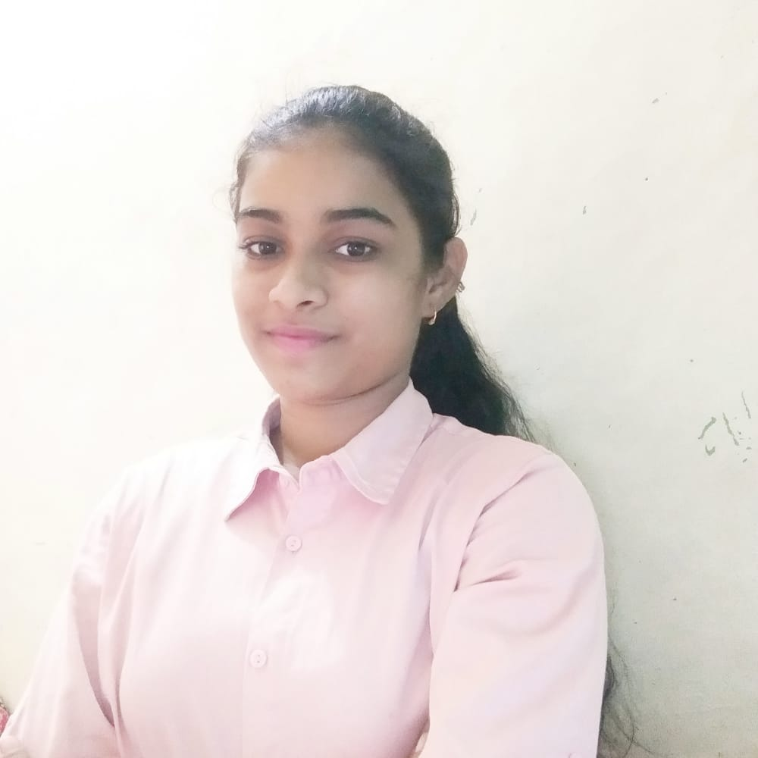
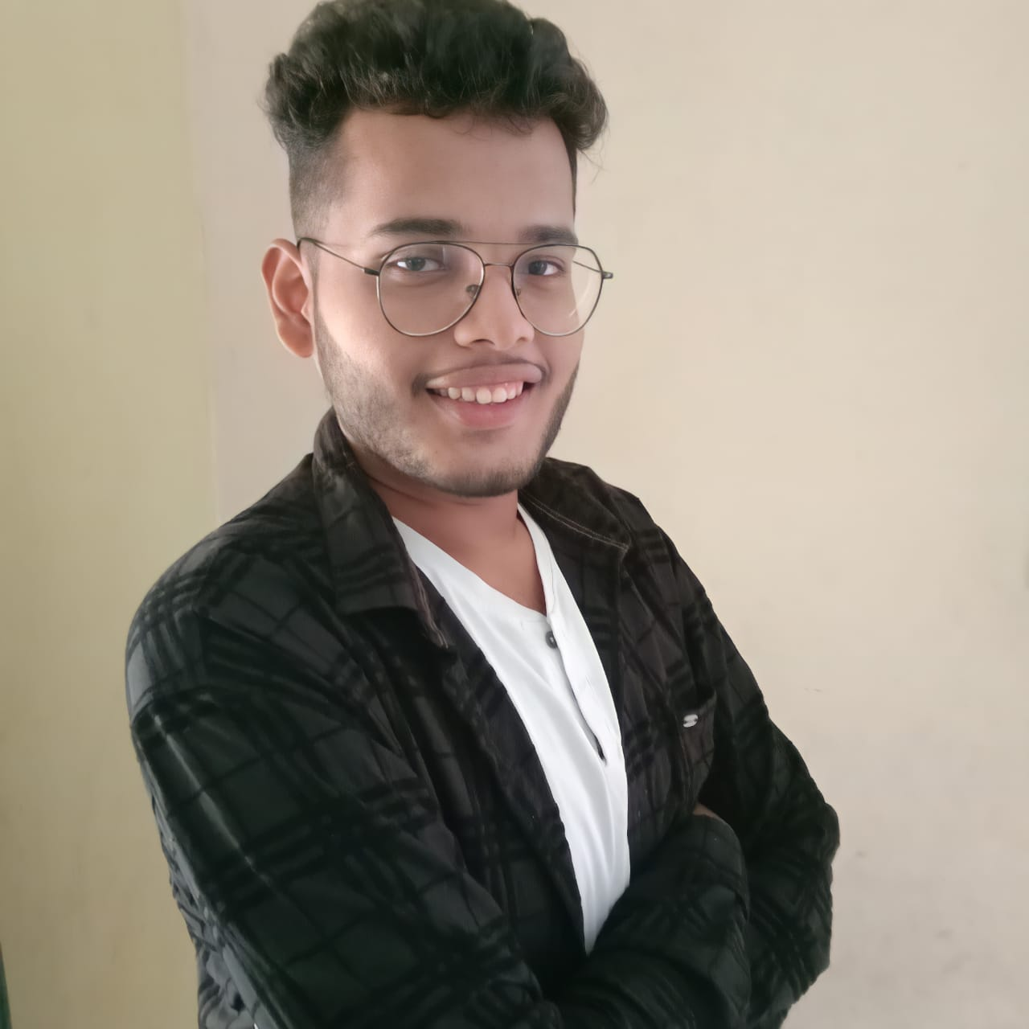
Vice Chair-person of ESSA
Ms. Tejaswini Gawande
Vice Chair-person of ESSA
Mr. Yash Deshmukh .
Tasks:-
Maintaining Work monthly report .
Keeping fair event History.
Formal documentations like letters and mail content to faculty.
Chair-person’s representation if needed .

Slide 4
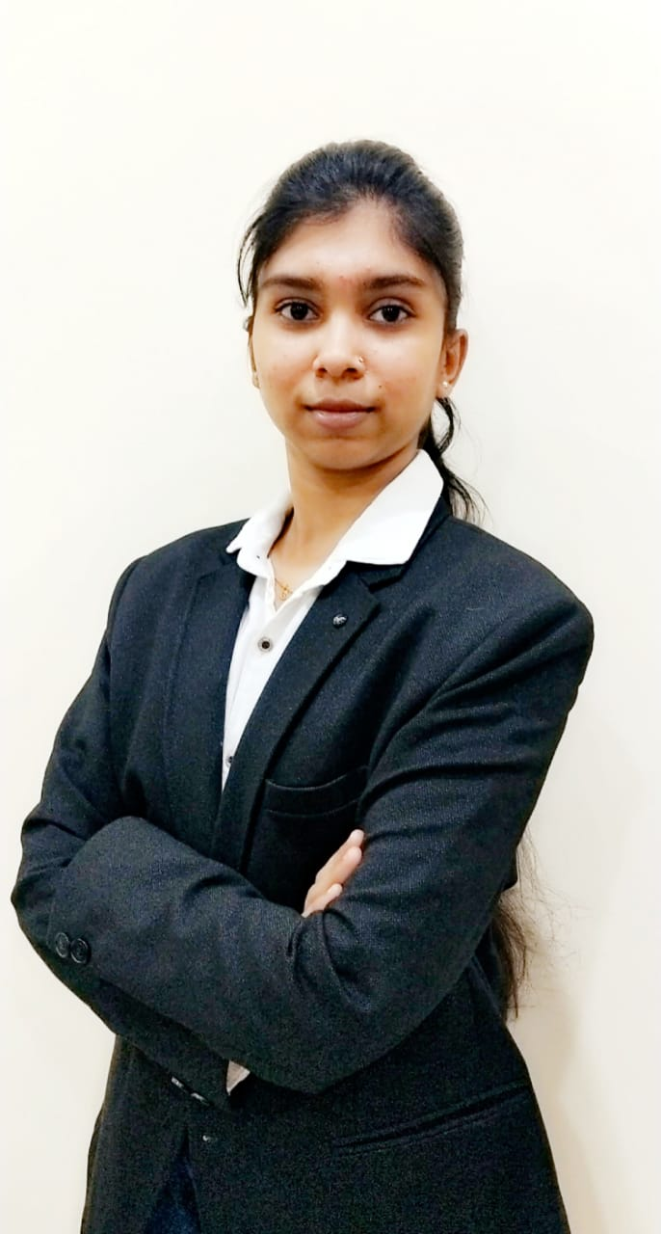
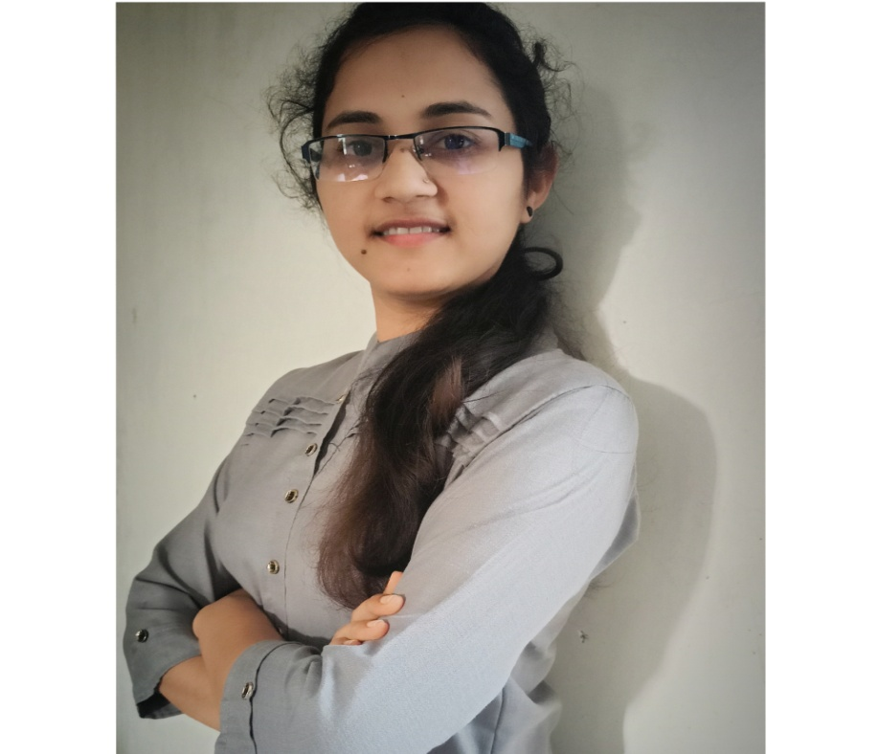
Secretary of ESSA
Ms. Astha Bhidekar
Joint-Secretary of ESSA
Ms. Kalyani Bhagwat
Tasks:-
Maintaining fair documents and saving in official drive .
Taking data report from Team heads and looking after the behavior of the whole team.
Time scheduling and managing time .
Maintaining Weekly work report .

Slide 5
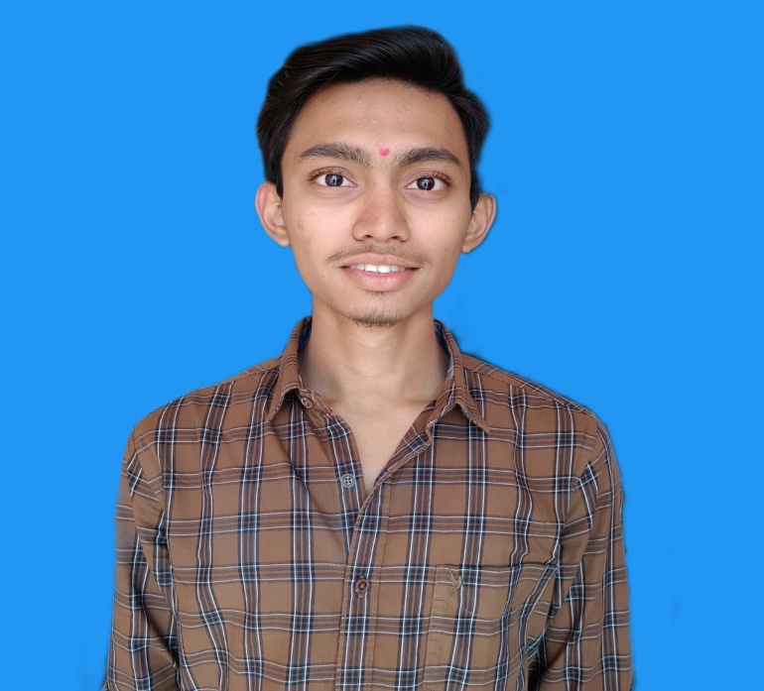
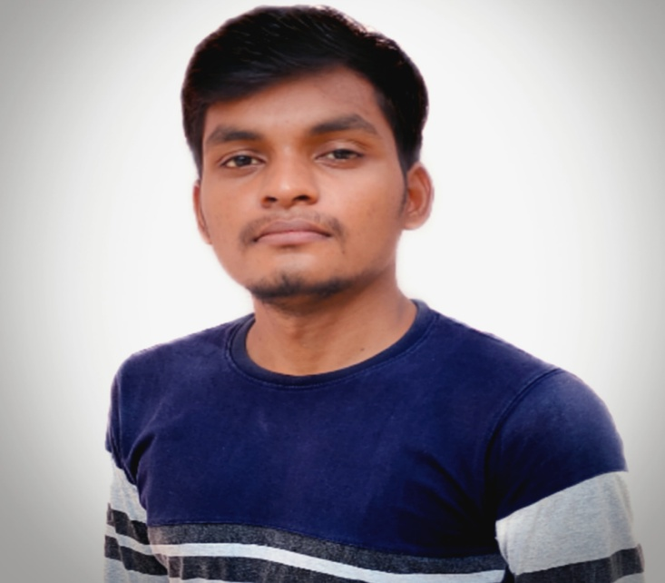
Technical-Head of ESSA
Mr. Bhushan Hajare.
Technical-Member(core) of ESSA
Mr. Sumit Bhute .
Tasks:-
Leadership of Technical team .
Managing and controlling all the proper work flow of Technical stuff.
Whenever there is needed should adapt the technical skills also teaching to the team members if anyone don’t have needed knowledge .
Responsibility of maintaining the privacy and security of ESSA by mean of technical accent .

Slide 6
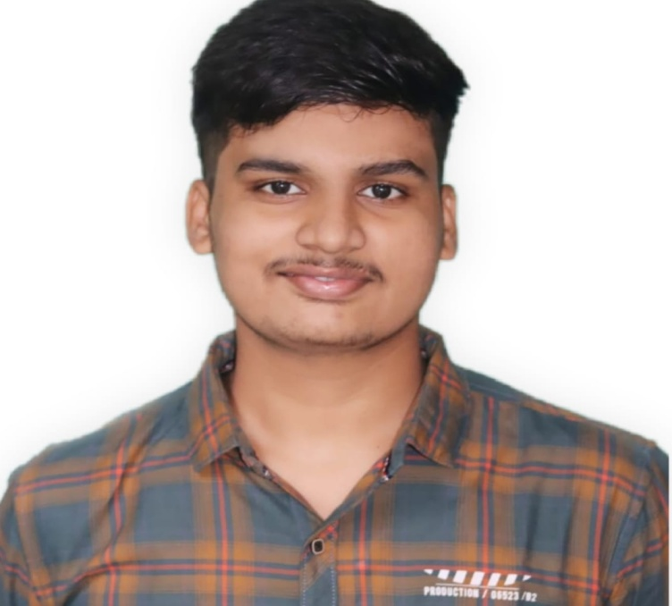
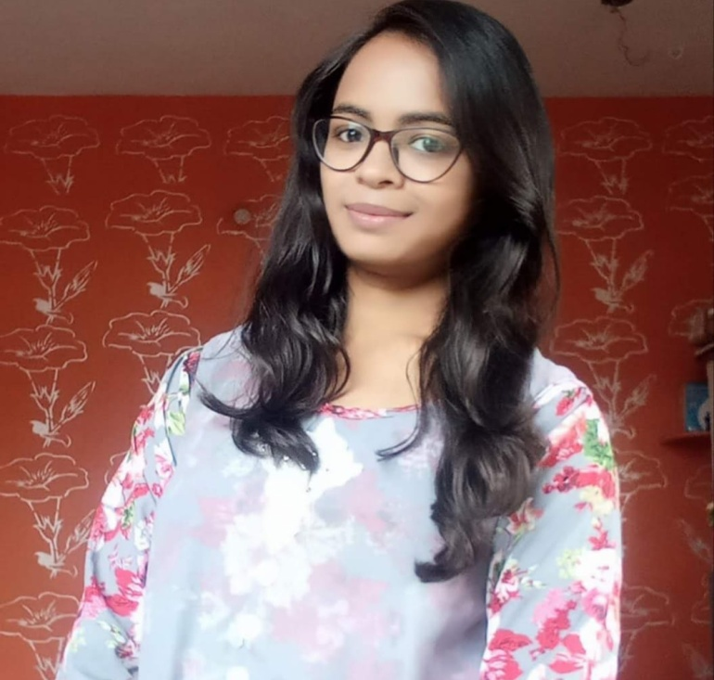
Publicity-Head of ESSA
Mr. Gaurav Bandhaokar
Publicity-Head of ESSA
Ms.Vaishnavi Rakhunde .
Tasks:-
Leadership of Publicity team .
Managing and controlling all the social pages of ESSA.
Posting the social media posts on behalf of Publicity Team.
Responsibility of maintaining the privacy and security of social pages of ESSA .

Slide 7
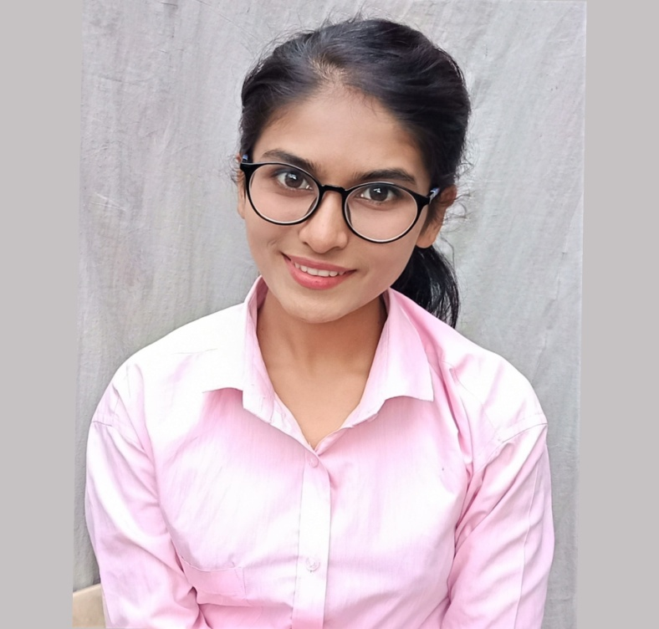
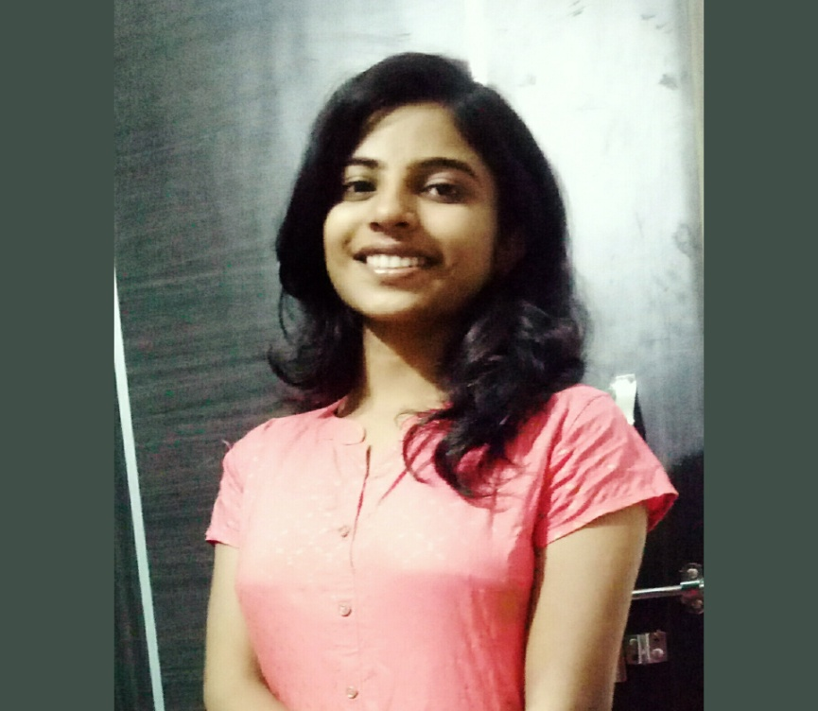
Creativity-Head of ESSA
Ms. Pallavi Kokate
Creativity-Head of ESSA
Ms. Sakshi Vaidya
Tasks:-
Leadership of Creativity team .
Managing and controlling proper workflow of Creativity team.
Providing posts for the social media pages on behalf of Creativity team .
Responsibility of making as well as editing Creative stuff like posters ,ppts, videos .

Slide 8
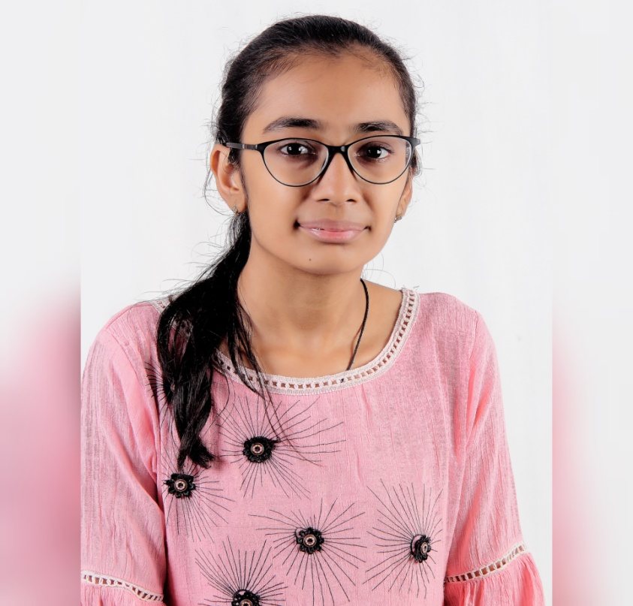
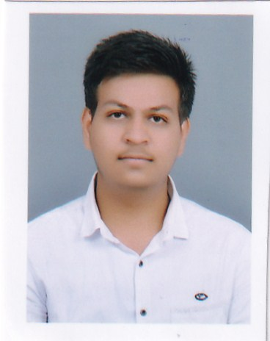
Program-Manager of ESSA
Ms. Krishna Ruhatia
Resource-Manager of ESSA
Mr. Yash Ashtikar
Tasks:-
Leadership of Program management team .
Managing and controlling proper workflow of Program Management team.
Responsibility of perfect organization .
Anchoring in events .
Tasks:-
Leadership of Resource team .
Managing and controlling proper workflow Resource team .
Responsibility of providing all the needed resource for event .

Slide 9
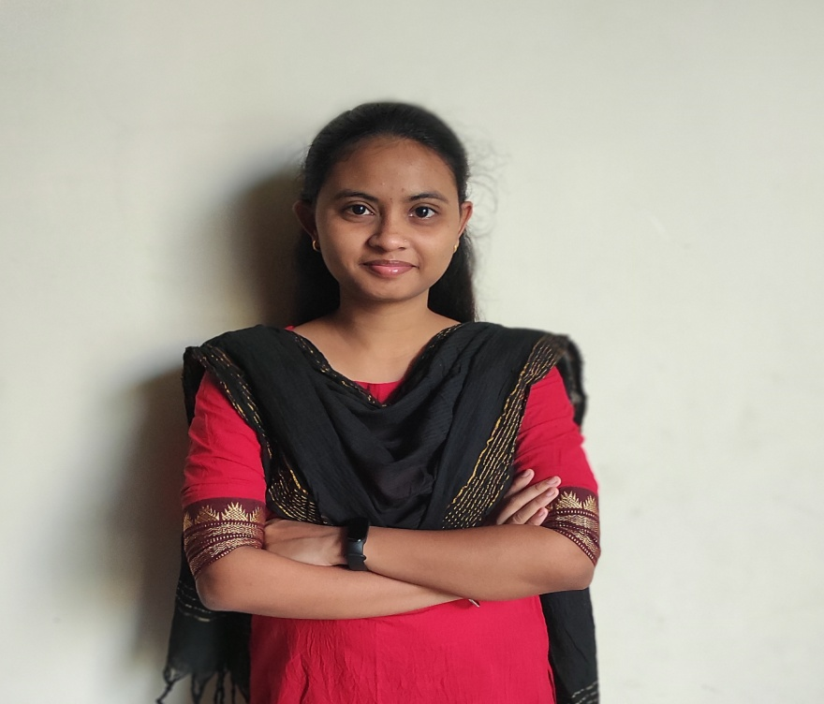
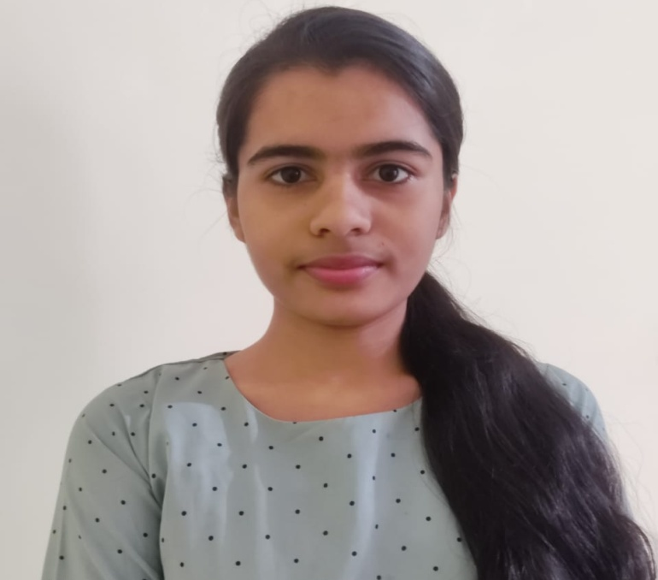
Treasurer of ESSA
Ms. Prajakta Gautore
Publicity-Member(core) of ESSA
Ms. Rutuja Modak
Tasks:-
Cost Estimation .
Responsibility of proper money management and proper expenses .
Tasks:-
Managing and controlling all the social pages of ESSA.
Posting the social media posts on behalf of Publicity Team.

Slide 10
Technical executive team-members
Jayesh Choudhari
Swikruti Shah
Arya Chandrawanshi
Sejal Shripat
Task:-
Recording (if online )all sessions /meets and uploading it as public when it is needed.
Solving all technical issues and training to those who don’t have knowledge of any session .
Helping in website’s work as well as other technical related work .

Slide 11
Creativity executive team-members
Janhavi Mudolkar .
Prathamesh Gattani
Dipali Agrawal .
Vaishnavi Chobe.
Task:-
Making docs and content like notice ,message,posters,mail,letters ,etc.
Creating posts for social pages.

Slide 12
Program Management Executive team-members
Kartik Shingade.
Nikita Jadhav .
Harsh Drona.
Shushti Naealkar
Task:-
Organizing events .
Anchoring.
Google forms ,email or direct communication with participants.

Slide 13
Resource executive team-members:-
Samrudhi Thote.
Lokesh Hiwarkar .
Janvee Mahajan.
Khushi Vidhale.
Task:-
Maintaining all resource data like photos ,docs, ppts,posters,etc.
Participant’s data management .

Slide 14
Publicity executive team-members:-
Mrunal Patil
Krishna Shende
Payal Talmale .
Yash Wankhade.
Task:-
Handling all social media pages .
Feeding and uploading posts .
Editing and decorating videos to post.

